Slide 1
Angular Demos Core Dynamic Features {{ expr }}, *ngFor, *ngIf @Component … @Input @Output (upgraded to Angular 17)
arnaud.nauwynck@gmail.com
Course Esilv 2024
This document: https://github.com/Arnaud-Nauwynck/presentations/web/ angular-demos-2-ngFor-ngIf-component.pdf

Slide 2
Outline
templateHtml {{ expr }}
*ngFor, @for() { }
*ngIf, @if() { }
@Component
[] .. @Input field, input()
() .. @Output changed, output()
[()] .. Bidirectional Binding, model()
router

Slide 3
Outline
templateHtml {{ expr }}
*ngFor, @for() { }
*ngIf, @if() { }
@Component
[] .. @Input field, input()
() .. @Output changed, output()
[()] .. Bidirectional Binding, model()
router

Slide 4
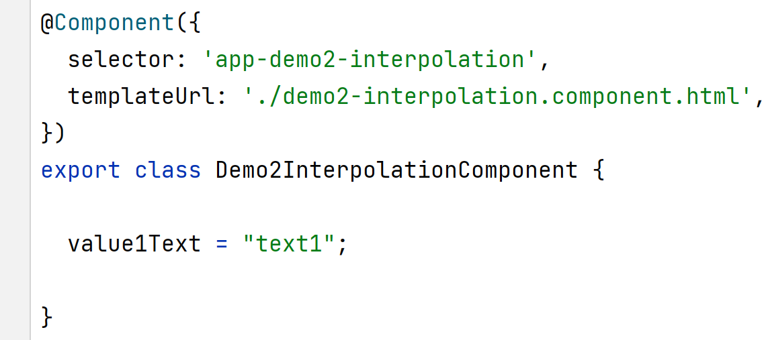
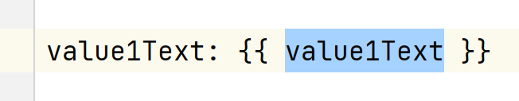
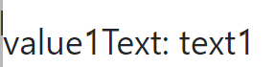
Interpolating {{ expr }} in template Html
In component.ts
In (template) component.html
Result DOM

Slide 5
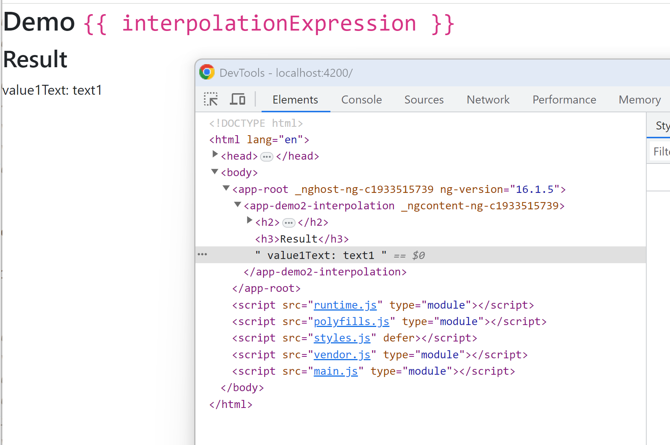
Checking with Chrome debugger (F12)

Slide 6
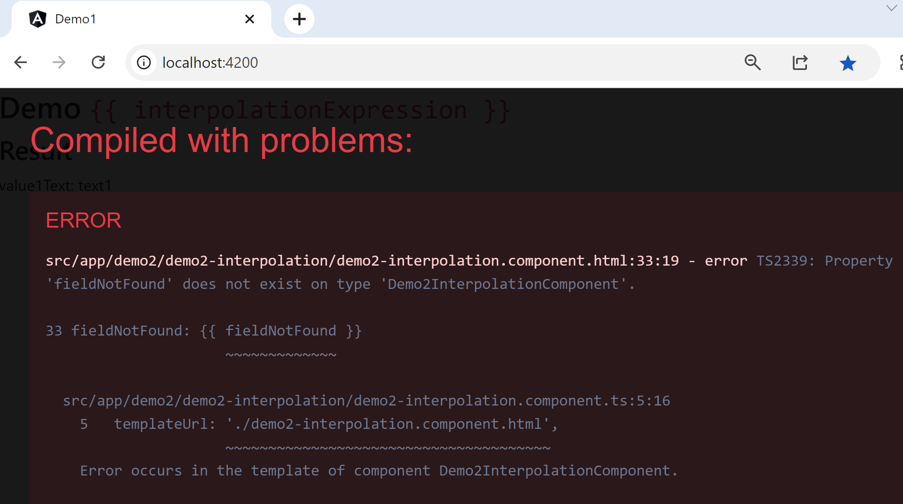
What if {{ fieldNotFound }} ?

Slide 7
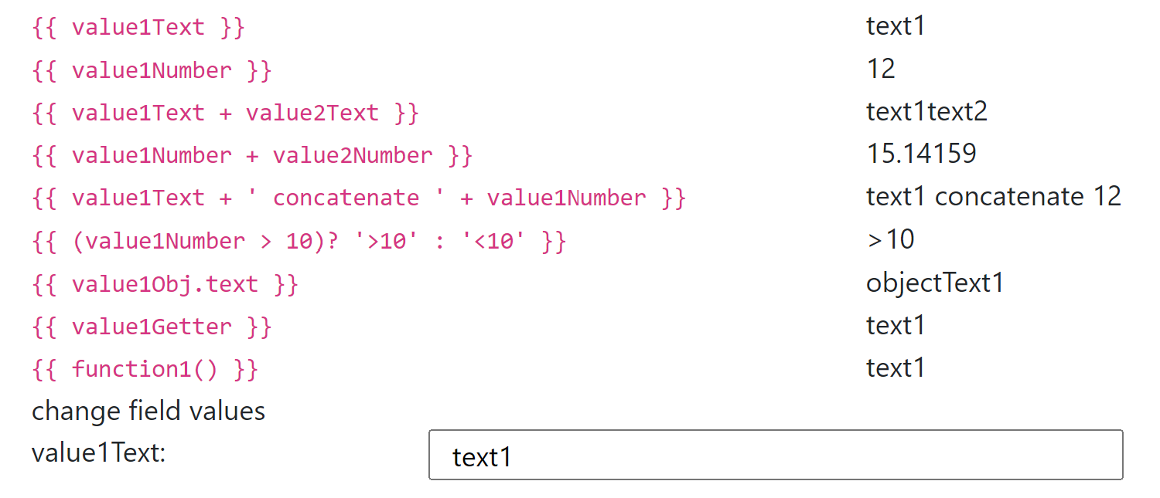
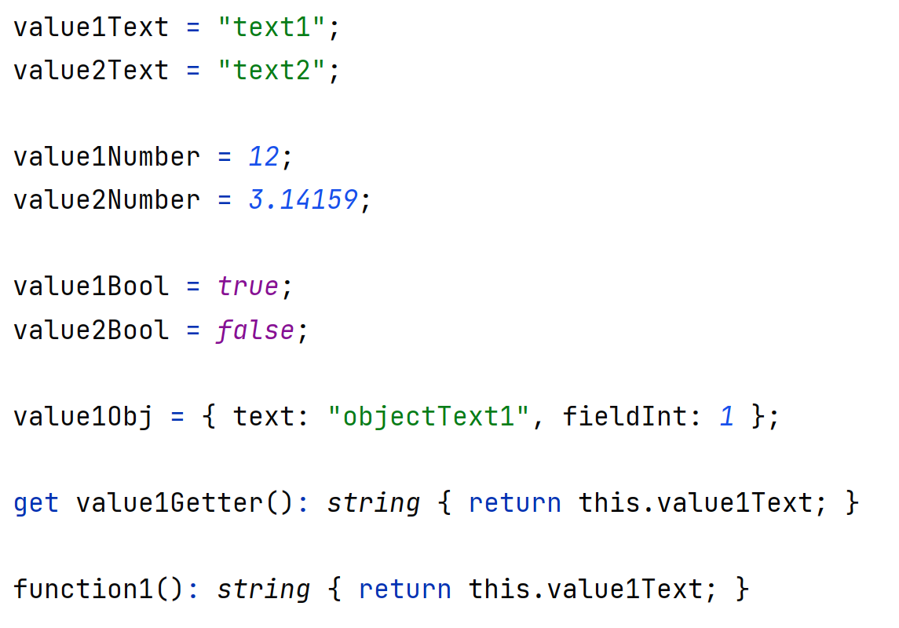
Demo {{ complexExpr }}

Slide 8
Outline
templateHtml {{ expr }}
*ngFor, @for() { }
*ngIf, @if() { }
@Component
[] .. @Input field, input()
() .. @Output changed, output()
[()] .. Bidirectional Binding, model()
router

Slide 9
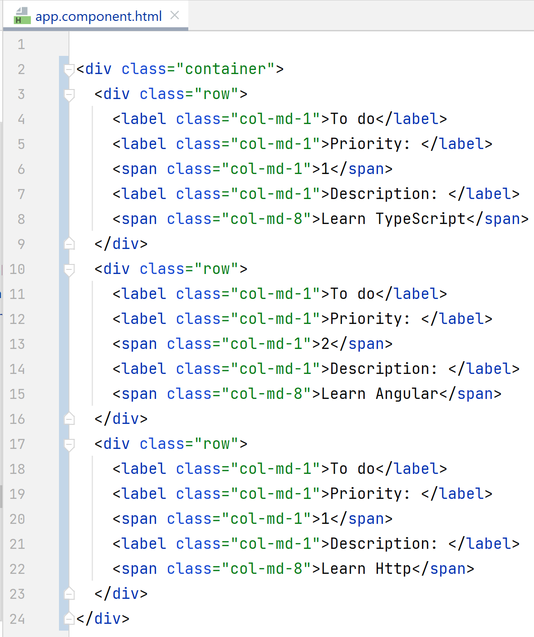
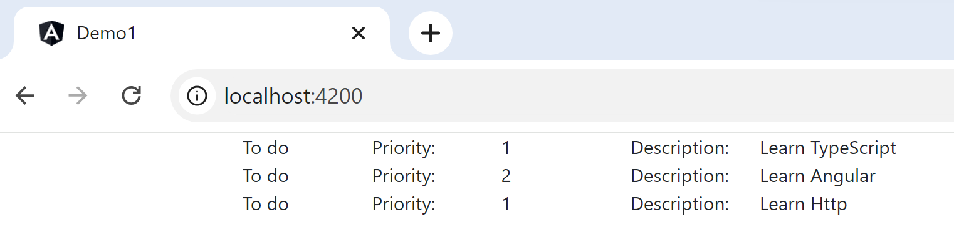
Demo *ngFor
Expected html …
but without copy&paste

Slide 10
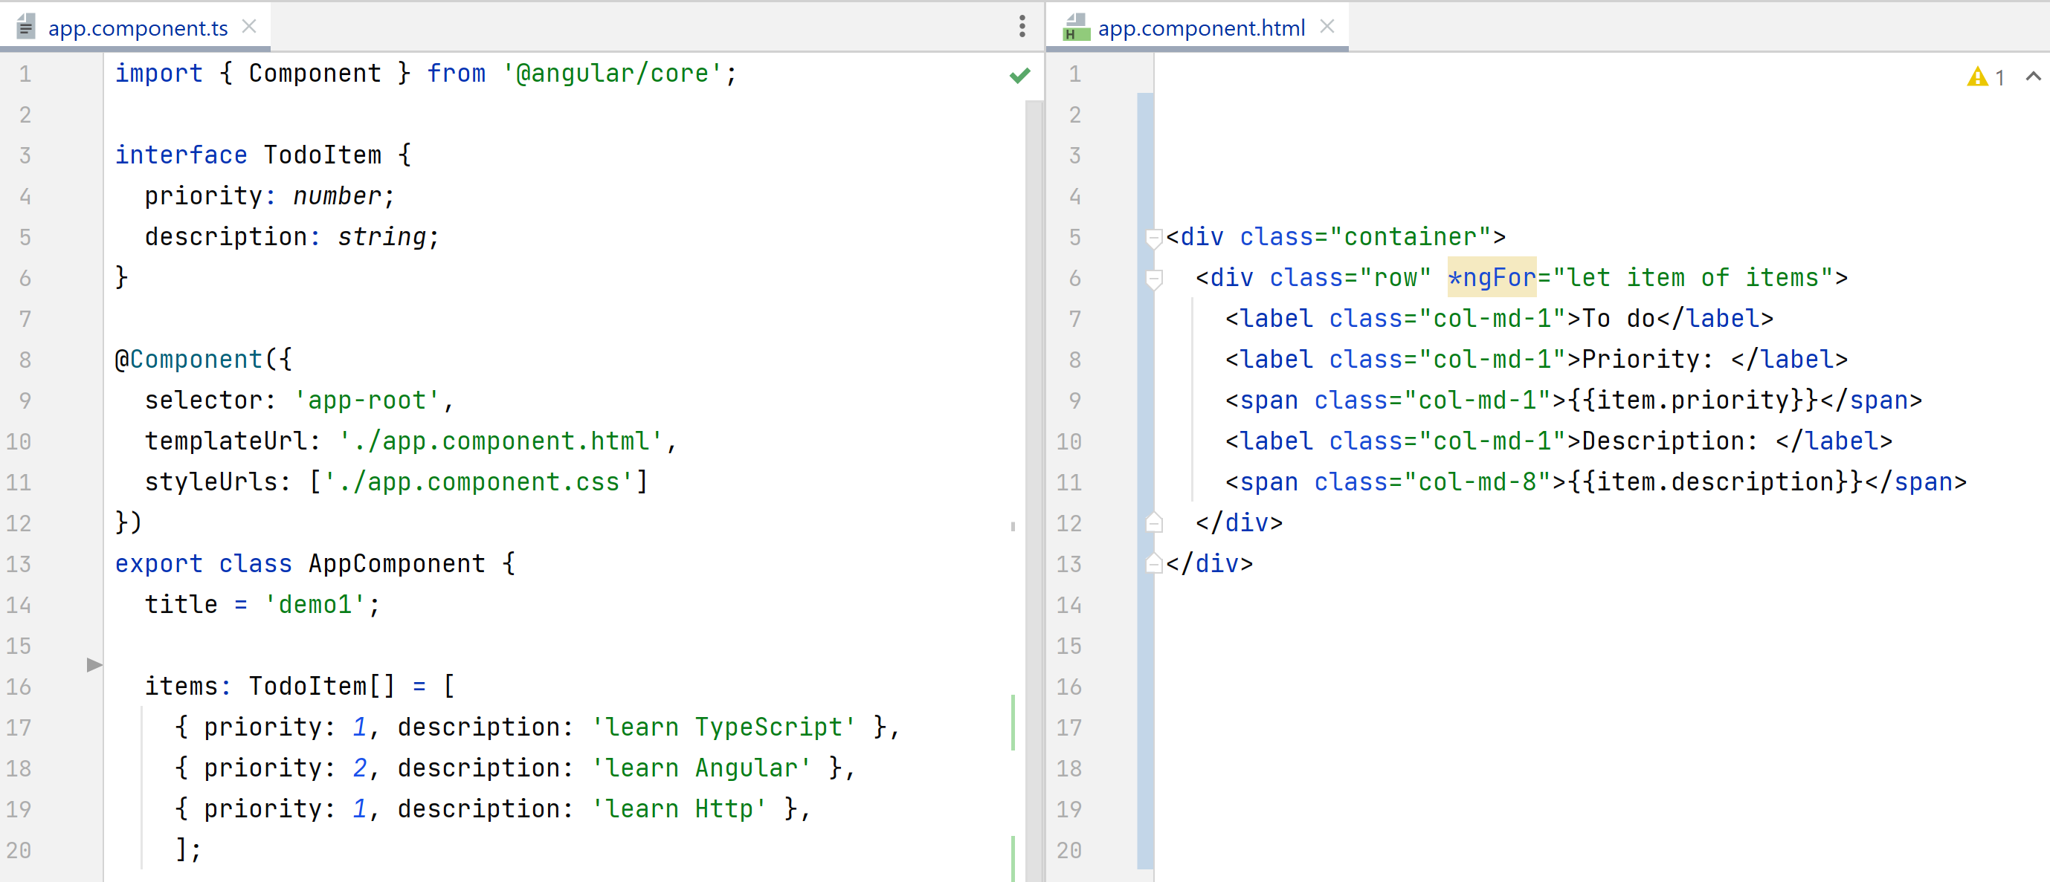
*ngFor: Applying MVC Design Pattern : splitting Model (json / javascript) – View (Html)

Slide 11
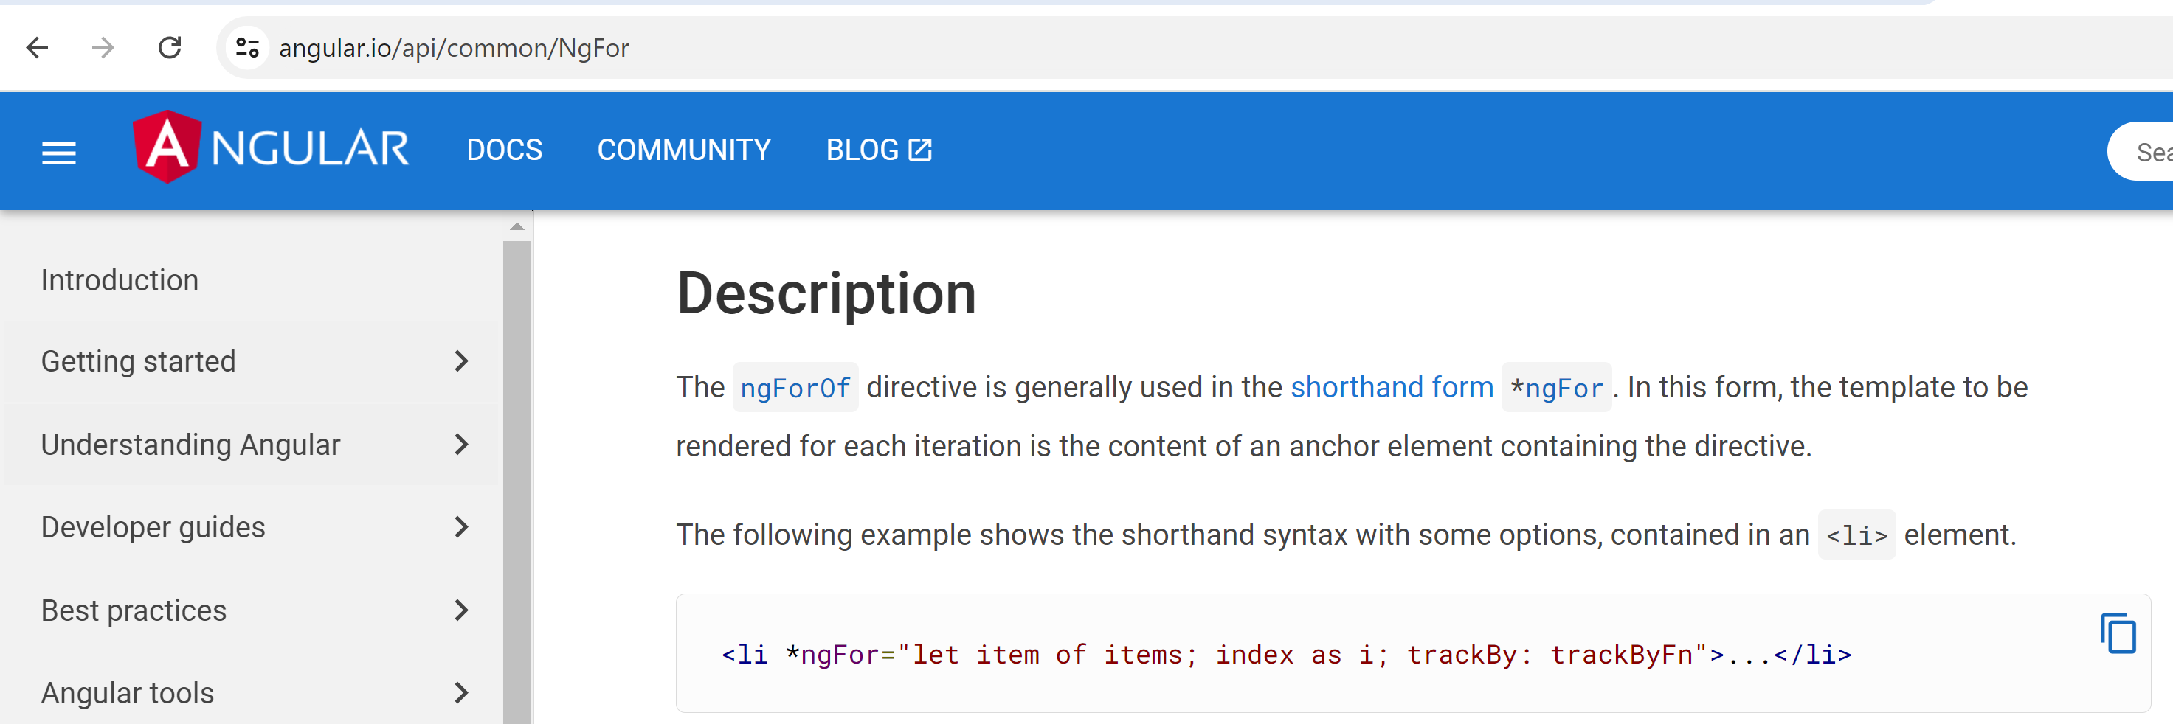
*ngFor
Local variable aliases:
Index, count, first / last, even / odd
trackBy:
For incremental optims and transitions

Slide 12
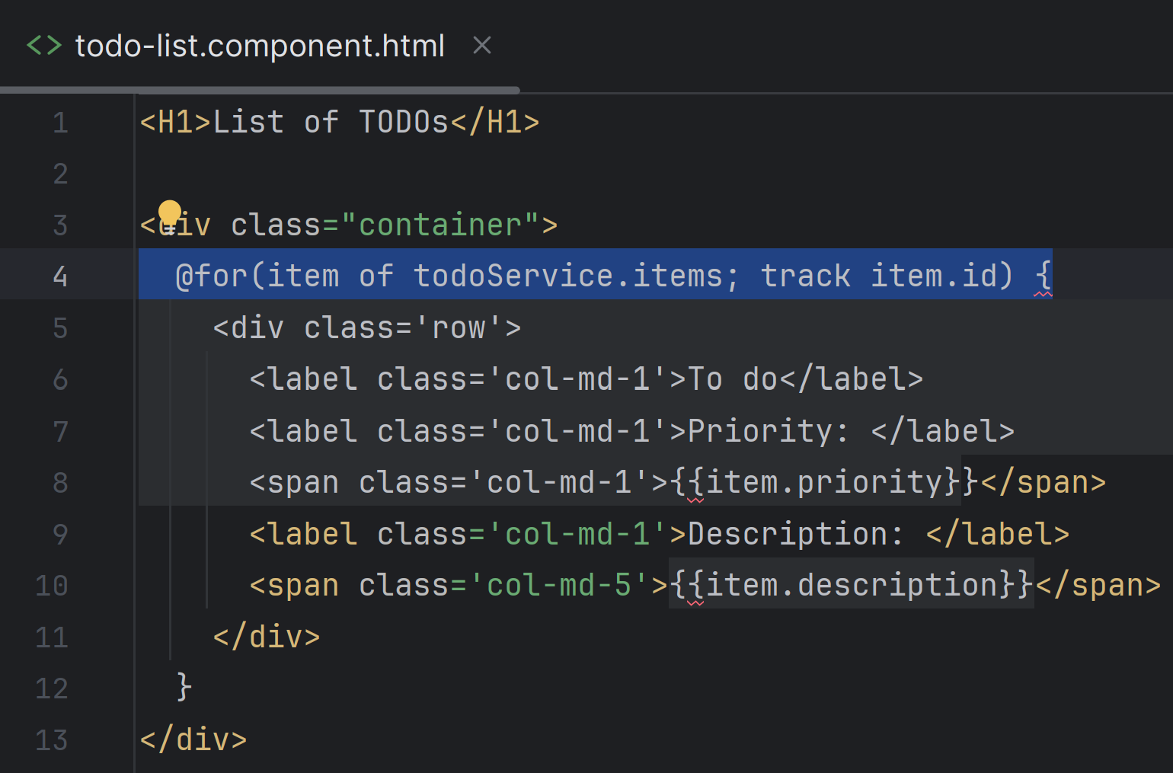
@for(item of list; track item.id) { ... }
Angular >= 17

Slide 13
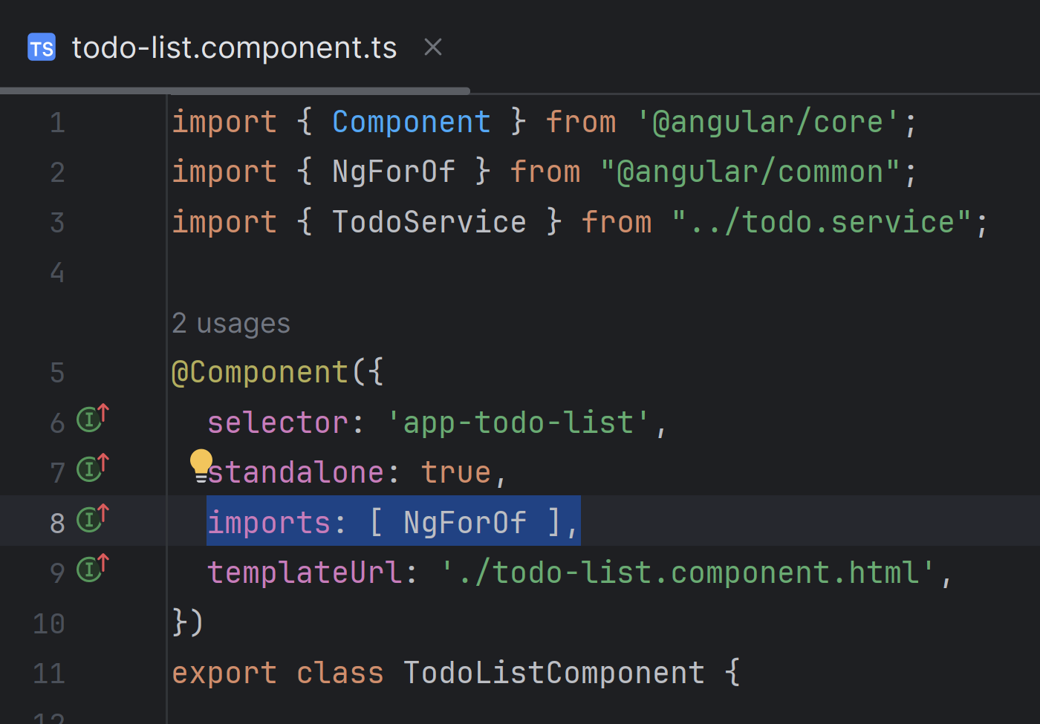
imports: [ NgForOf ]
Angular >= 17

Slide 14
Outline
templateHtml {{ expr }}
*ngFor, @for() { }
*ngIf, @if() { }
Chrome Debugger
@Component
[] .. @Input field, input()
() .. @Output changed, output()
[()] .. Bidirectional Binding, model()
router

Slide 15
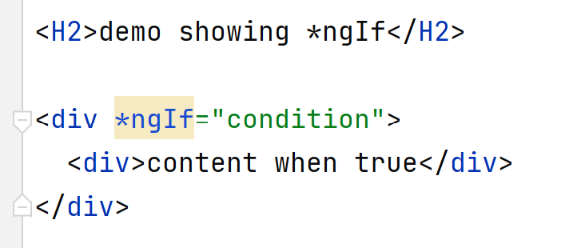

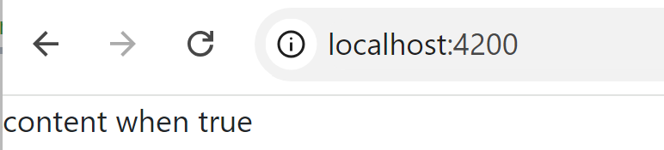
*ngIf

Slide 16
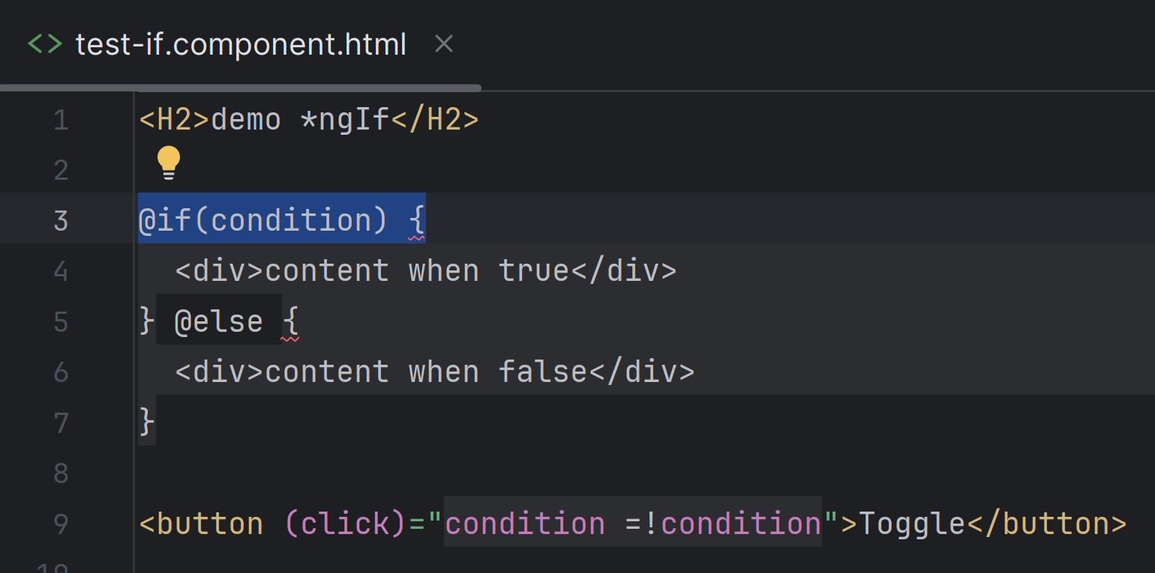
@if( ) { } @else { }
Angular >= 17

Slide 17
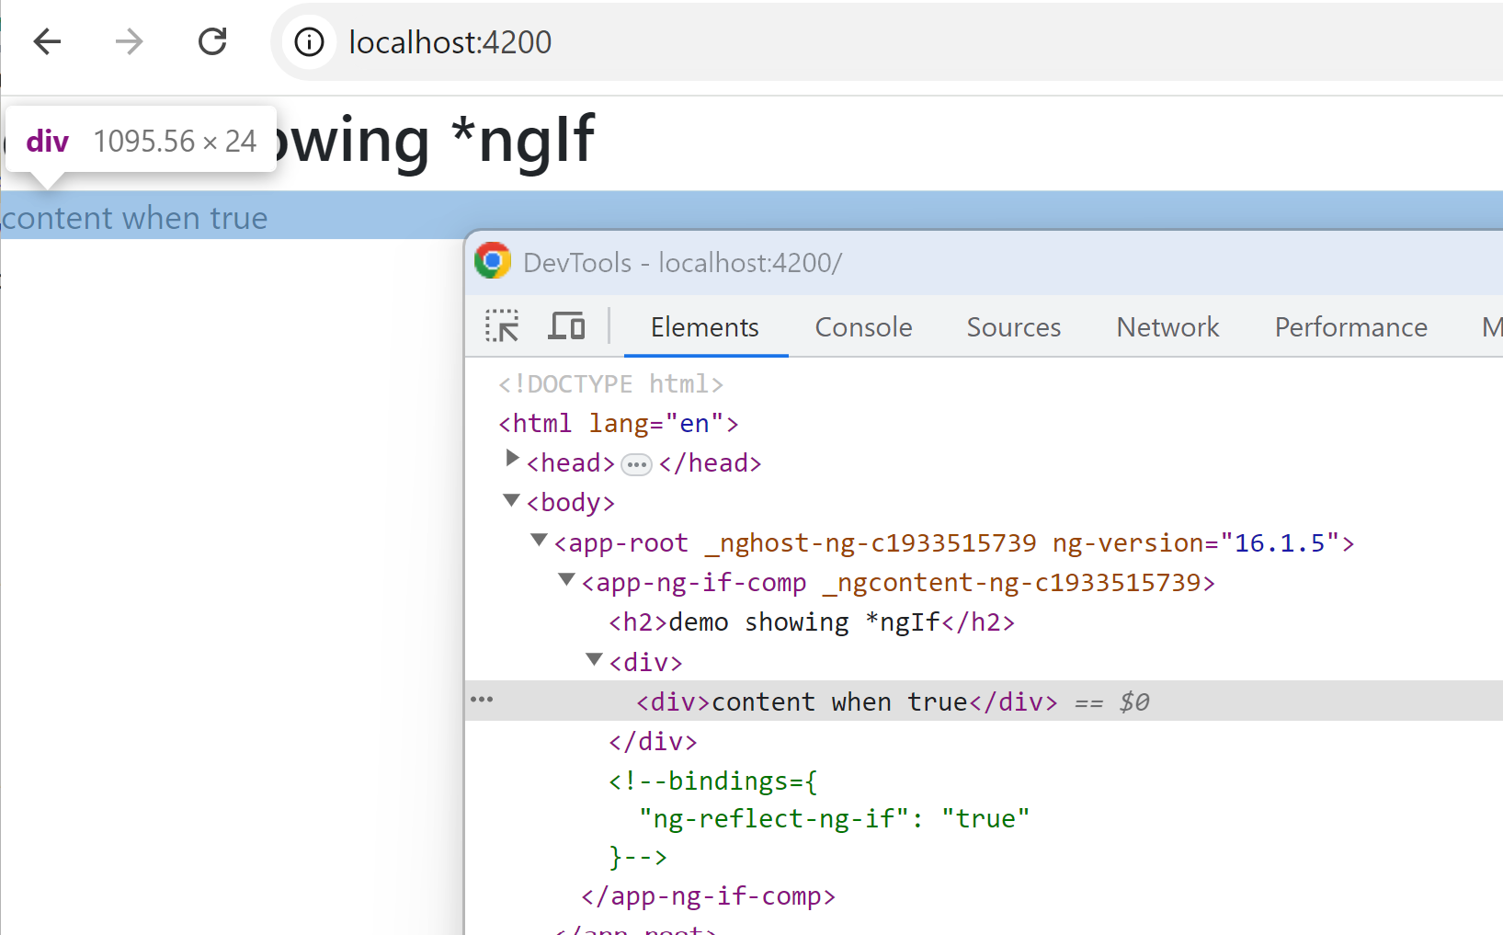
Result *ngIf => attribute removed, comment added

Slide 18
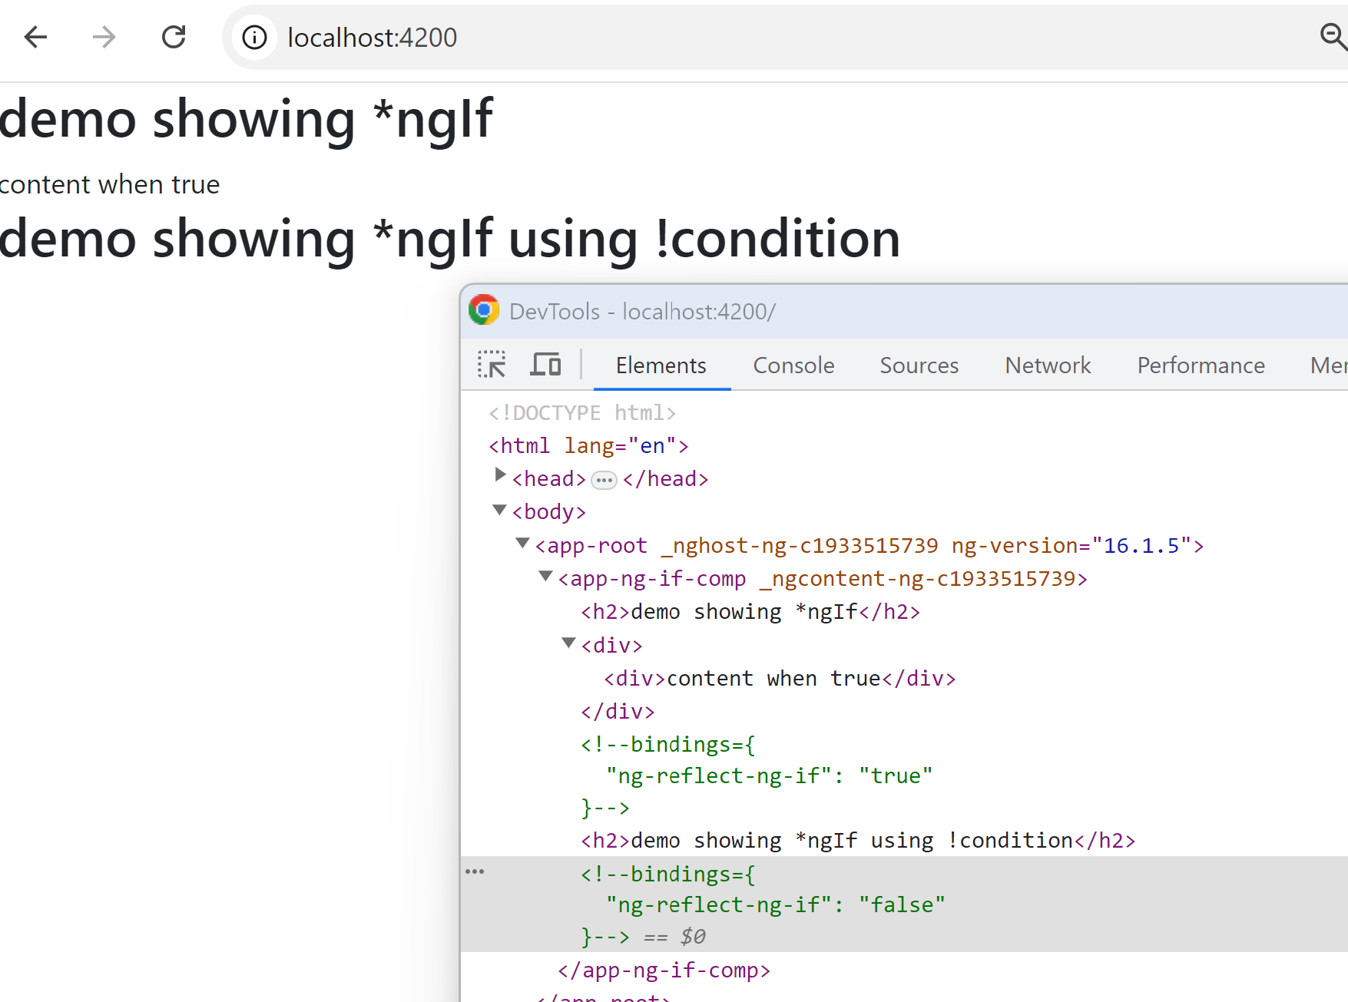
*ngIf when false => NO content

Slide 19
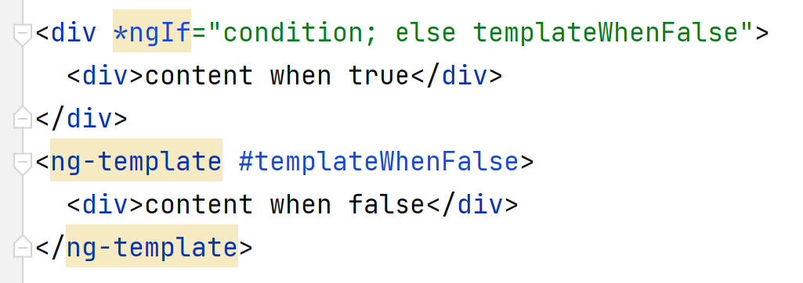
*ngIf … ; else contentTemplate => ng-template
Solution 1 : use both *ngIf=« condition » and *ngIf=« ! condition »
Solution 2 : use ng-template:
Solution 3 : use *ngSwitch

Slide 20
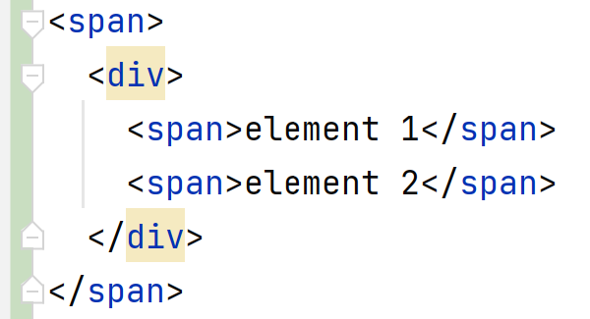
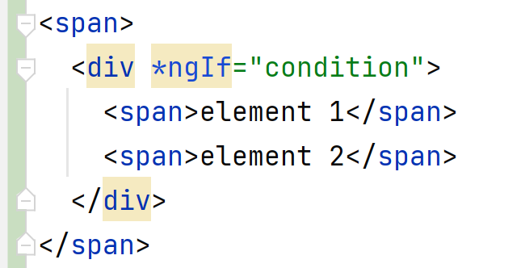
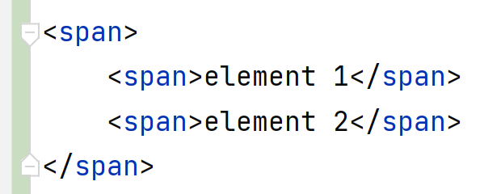
How to avoid extra <div> on *ngIf with multiple elements content ?
Actual content:
Possible problems:
CSS, divs overhead
INSTEAD… Expected content:
How to ???

Slide 21
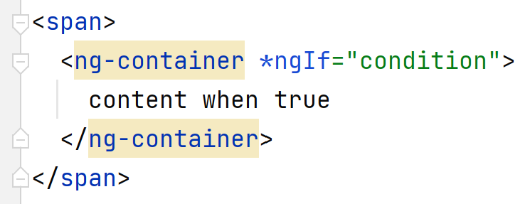
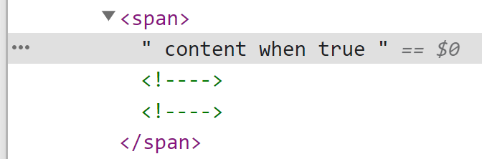
Using <ng-container *ngIf=..>

Slide 22
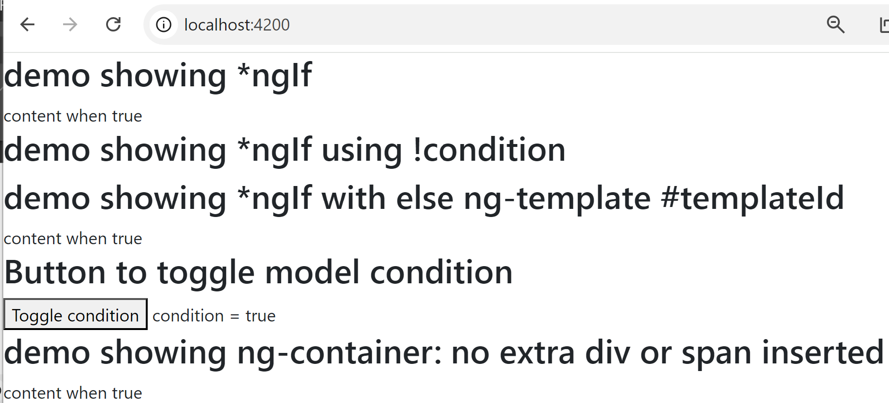
Demo *ngIf

Slide 23
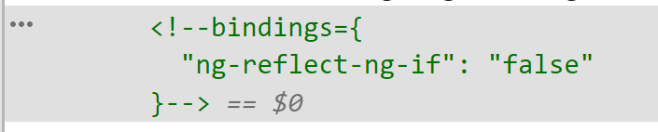

Remove <!-- bindings ..comment..--> ? « development» vs « production » conf
Default conf « development » :
$ ng serve
(implicit: ng serve –c development )
=> Has Chrome debugging comment
conf « production » :
$ ng serve -c production
=> Still empty placeholder comment but NO debugging info in it

Slide 24
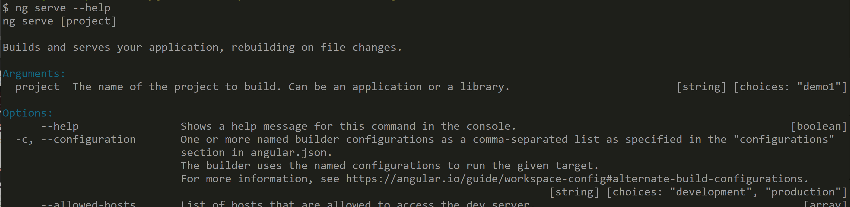
ng serve --help ; ng serve -c production

Slide 25
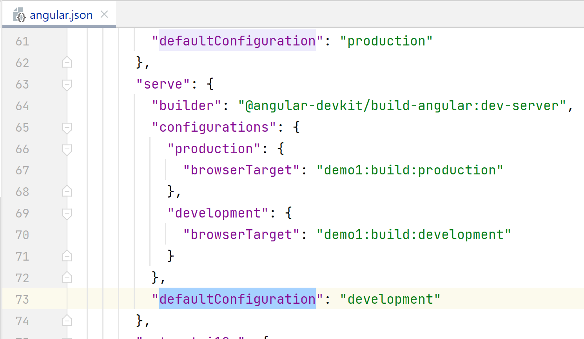
angular.json « development» vs « production » conf

Slide 26
Outline
templateHtml {{ expr }}
*ngFor, @for() { }
*ngIf, @if() { }
@Component
[] .. @Input field, input()
() .. @Output changed, output()
[()] .. Bidirectional Binding, model()
router

Slide 27
@Component
Goal : Avoid copy & paste,
Be able to insert re-usable html fragment aka « component »
« component declaration » ➔ « component re-use »
( Like « method declaration » ➔ method call )

Slide 28
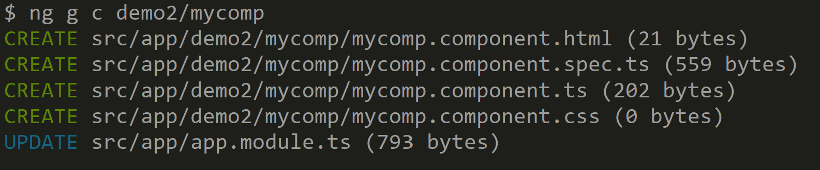
$ ng generate component
(short) $ ng g c

Slide 29
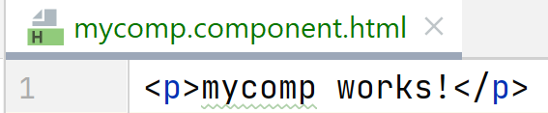
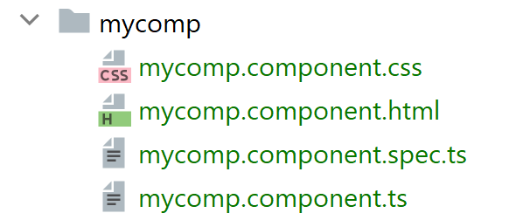
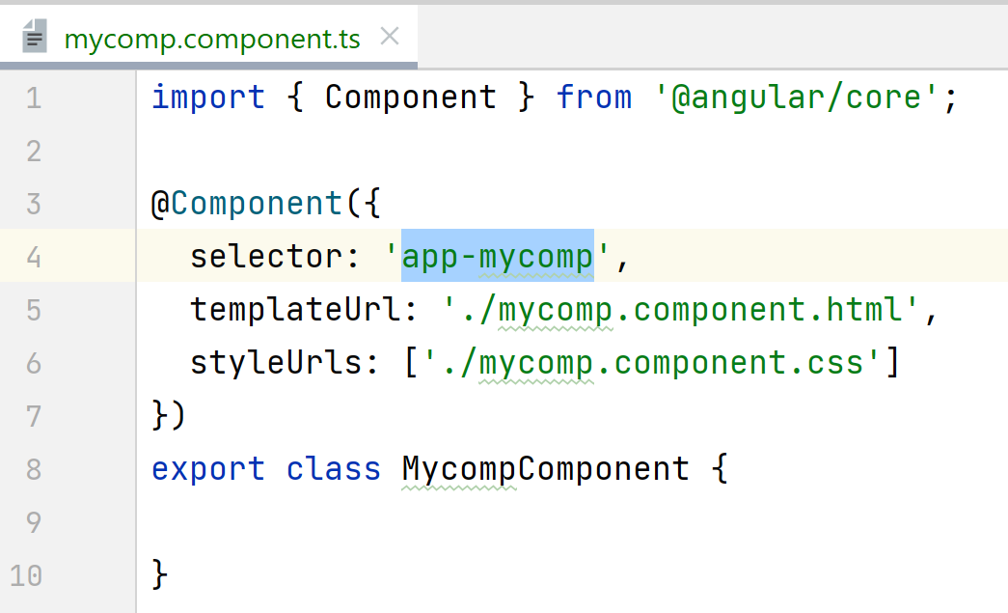

Generated @Component code
1 dir + 4 new files added
+ 2 lines inserted in module (cf next !)

Slide 30
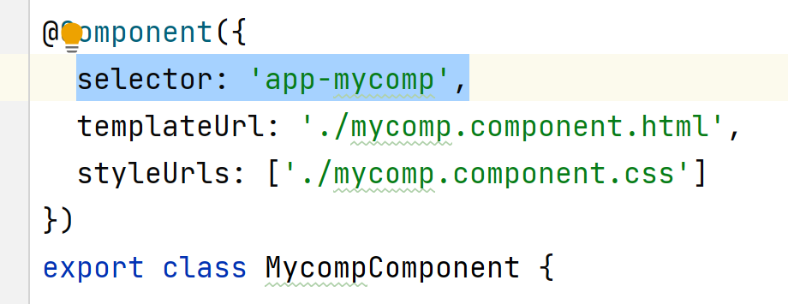
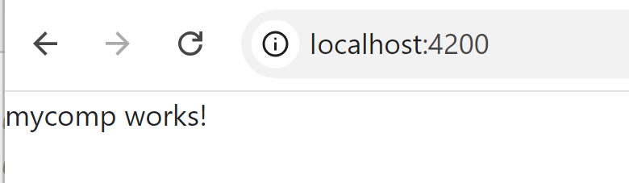
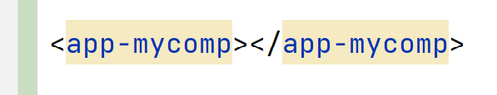
Using @Component … similar to html « Custom Element »
Declare component = assign selector (element name) to class
Use component = use selector as element type in html

Slide 31
Short @Component declaration
1/ styleUrls is optional (why global CSS overwrite?)
2/ templateUrl can be inlined (why using a file for 1..2 lines?)
3/ *.spec.ts generated unit tests may be removed or completed
( do not have assertions!)

Slide 32
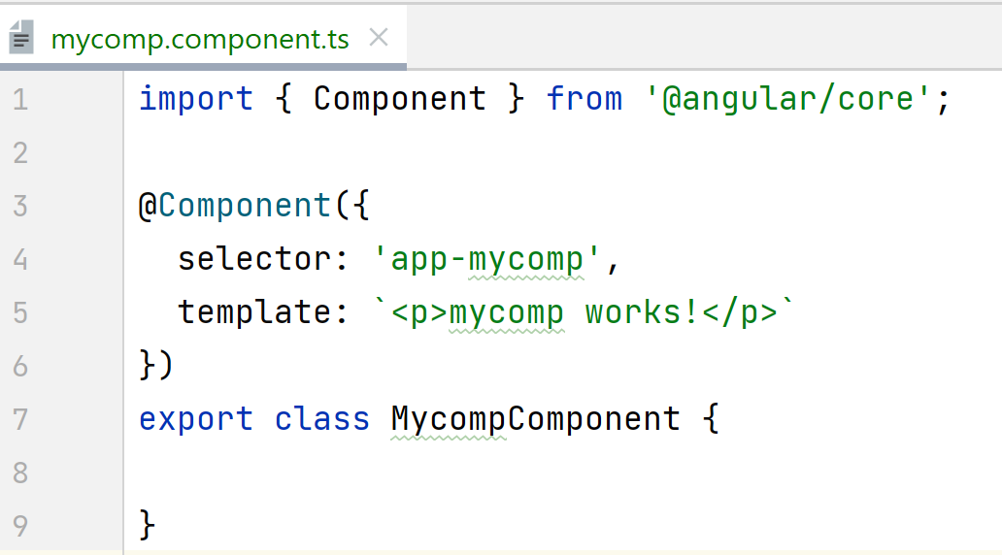

Short @Component declaration

Slide 33
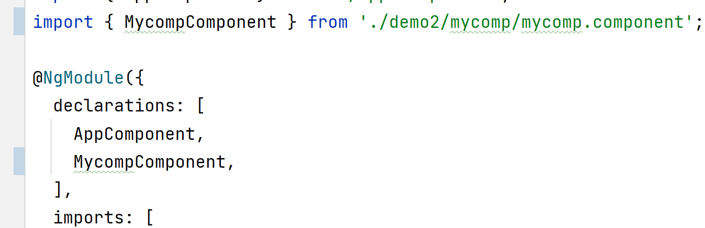
@Component… ADD in @NgModule declarations: [… ] !!!
1 dir + 4 new files added
+ 2 lines inserted in existing module !

Slide 34
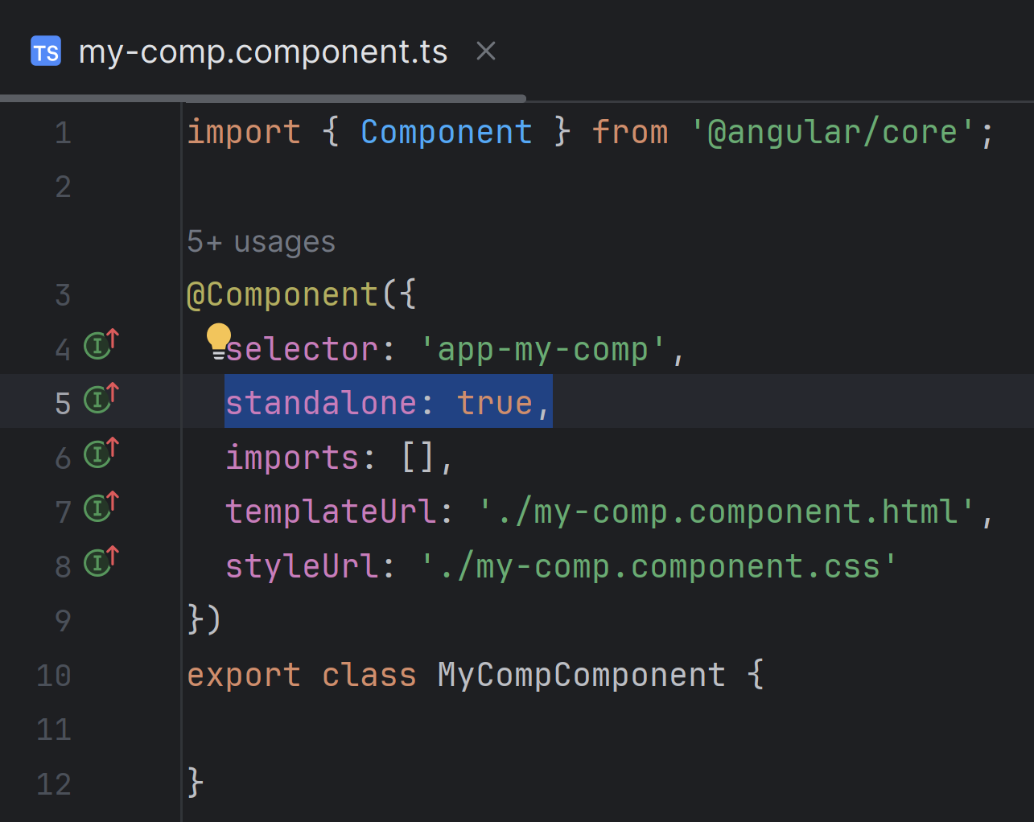

@Component standalone=true
Angular >= 17
1 dir + 4 new files added
no module !
no need to add in config

Slide 35
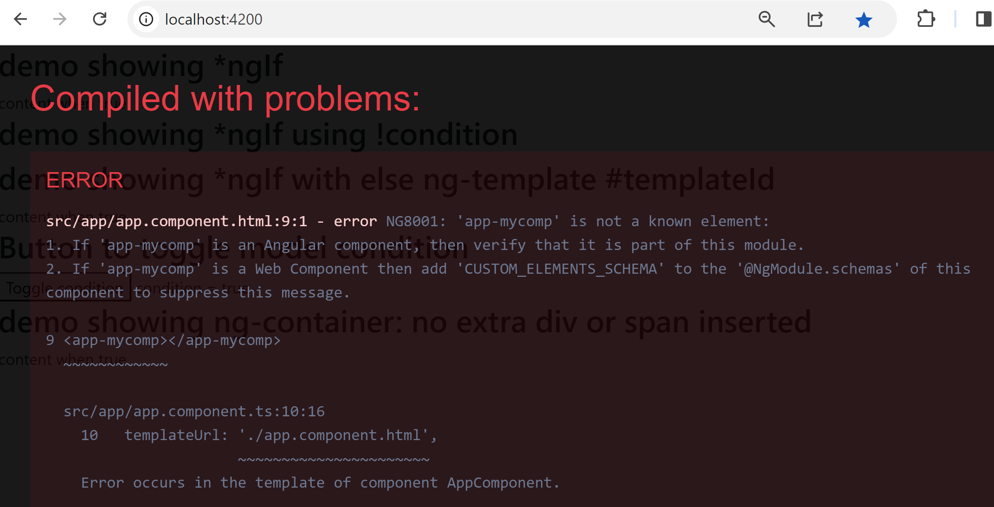
Using component, but forgetting to add in module

Slide 36
Edit, copy&paste … file module.ts becomes unmaintainable
Avoid modifying too many git commits / conflicts in same file
Common practices :
Solution 1/ split module in sub-modules
Solution 2/ split array declarations into constants sub-arrays

Slide 37
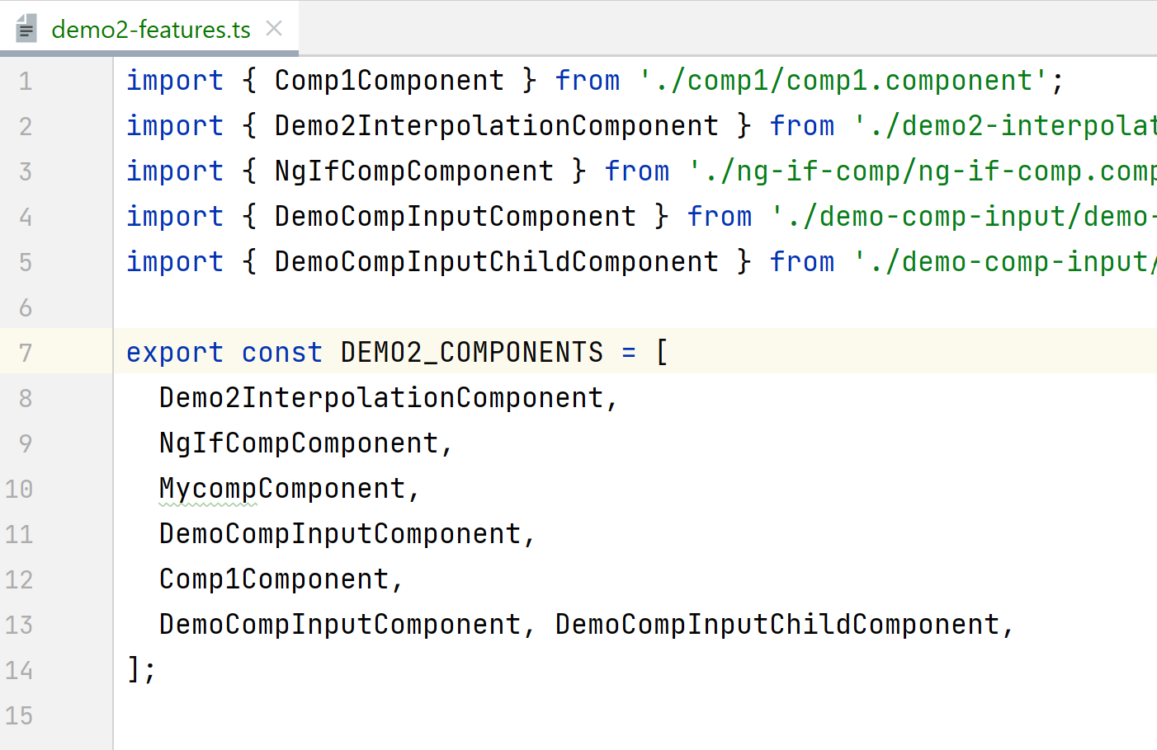
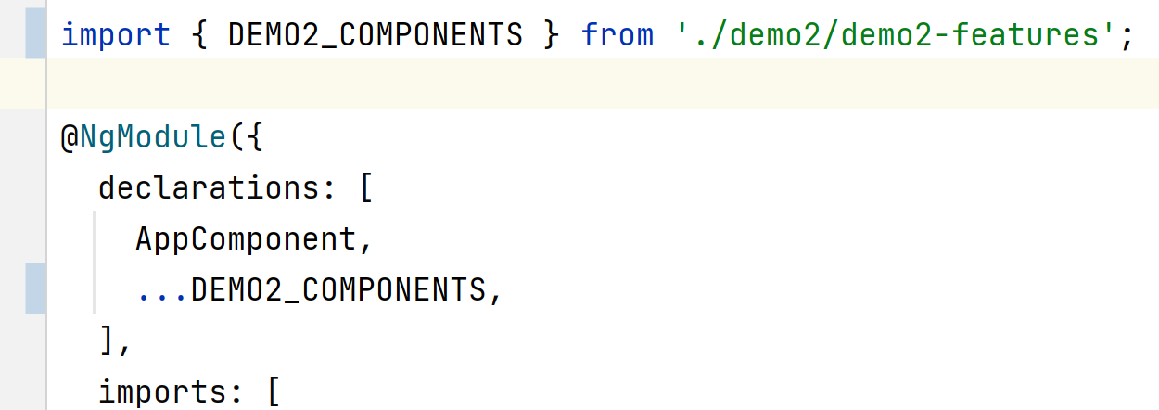
Split declarations with array (...spreading) const

Slide 38
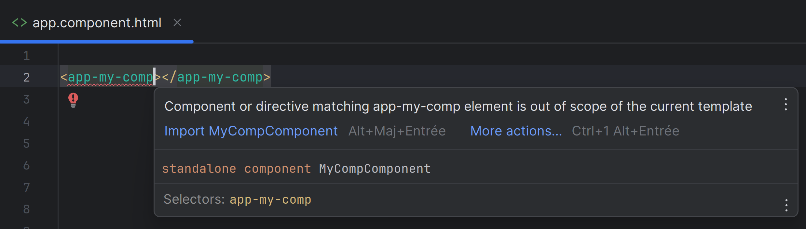
adding <app-my-comp />
Angular >= 17

Slide 39
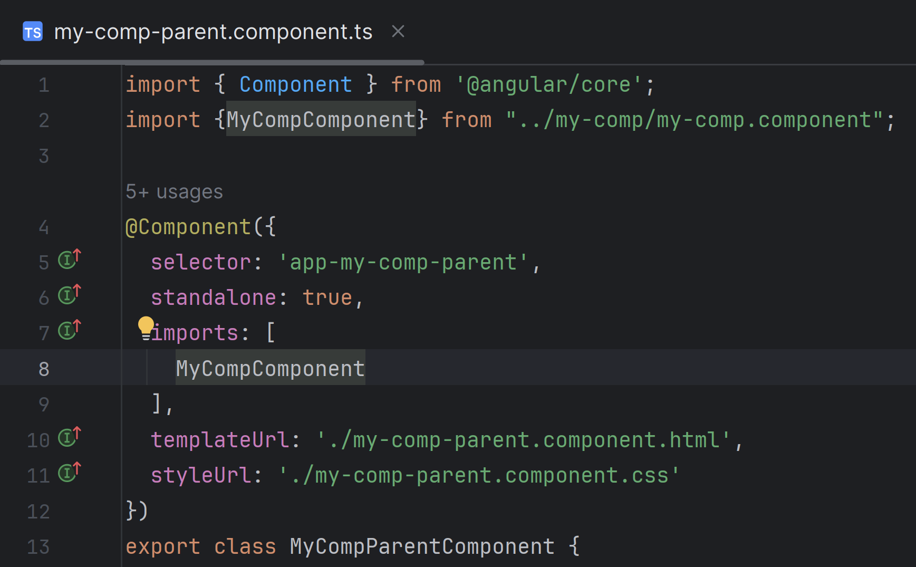
import { MyComp } from '..'; @Component({ imports=[MyComp], ..
Angular >= 17

Slide 40
Outline
templateHtml {{ expr }}
*ngFor, @for() { }
*ngIf, @if() { }
@Component
[] .. @Input field, input()
() .. @Output changed, output()
[()] .. Bidirectional Binding, model()
router

Slide 41
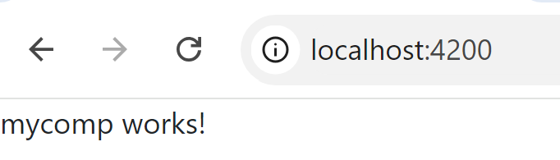
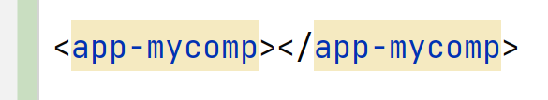
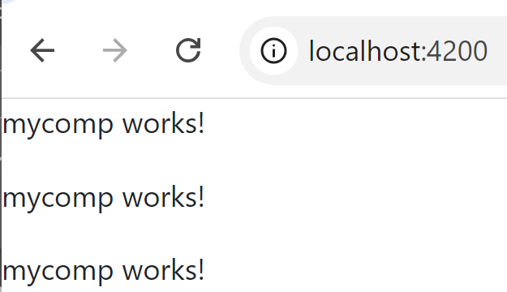
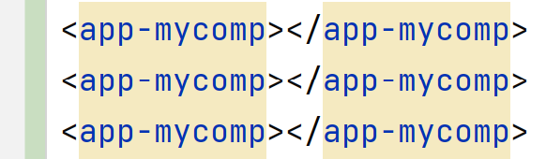
Using repeated (static) components … need dynamic binding

Slide 42
Binding between components : pass values / capture changes
[] One-Way data binding
= pass value from parent to child @input field
() change events binding = handle child @output change by parent code
[()] input+output = 2-Way data binding
= bind parent field to child field

Slide 43
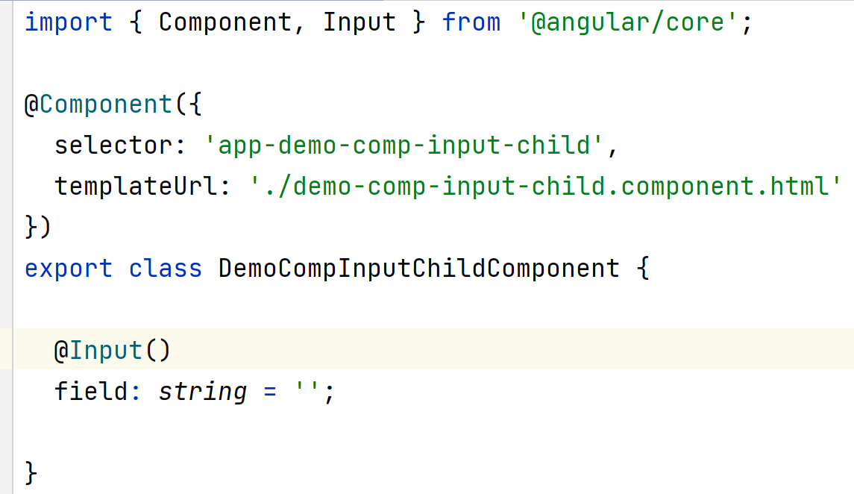
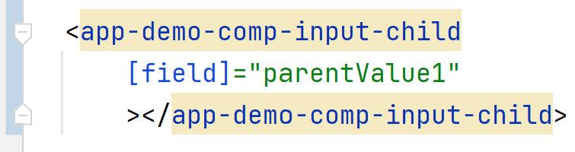
Declare @Input() field … then use [field]=«expr»
Child component.ts
Parent component.html

Slide 44
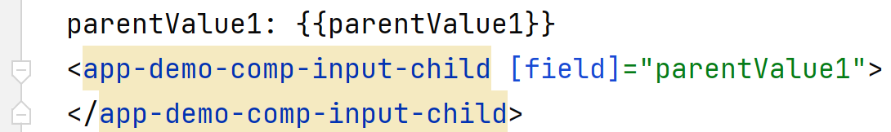



passing parent value to child component: <child [childField]=« parentValue »></child>
Parent component.html
Child component.html
One-Way Binding
Parent component.ts
Child component.ts

Slide 45

instead of "@Input() field: string" field = input()
Angular >= 17

Slide 46




:InputSignal<Type> instead of :Type
Angular >= 17
field is NOT modifiable from component
=> it is a "read-only getter" method
to use it, call "field()"
when forgetting parenthesis "()"
=> get

Slide 47
field = input(initialValue)
Angular >= 17
field can have initial value
=> type is implicitly infered
text in grey is additional display by IntelliJ, but not in file ! real file content :
field2 = input('');

Slide 48

field = input.required<Type>()
Angular >= 17
field can be "required"
when forgetting to set [field3]='...'

Slide 49

Demo One-Way binding [childField]=« expr »

Slide 50
Outline
templateHtml {{ expr }}
*ngFor, @for() { }
*ngIf, @if() { }
@Component
[] .. @Input field, input()
() .. @Output changed, output()
[()] .. Bidirectional Binding, model()
router

Slide 51

Using button callback: (click)=« code…»

Slide 52

(click) using implicit parameter « $event »

Slide 53

Click Demo … log in Chrome F12 > Console

Slide 54

$event detail

Slide 55

Chrome Debug breakpoint

Slide 56


Notice .. « ng serve –c production » => NO source « .map » code ! Can not browse to put breakpoint (obfuscated code)
Remark
Source .map

Slide 57

(click) on button is built-in … you can define your own @Output()
@Output() =
Observable
subscribed
from parent
components
.next(event)
Triggered in child component (click)

Slide 58


Subscribe to @Output : (childFieldChange)=« parentCallback ($event)»

Slide 59

field = output<Type>()
Angular >= 17

Slide 60

Chrome Debugger > « Call Stack » (parent ts)

Slide 61

Debugger Call Stack .. Parent caller[1] (parent html)

Slide 62

Debugger Call Stack .. Parent[2] caller (child ts)

Slide 63

Debugger Call Stack … Parent[3] caller (child html)

Slide 64



() = Change binding reverse way: child -> parent
Parent component.html
Child component.html
Parent component.ts
Change Binding
Child component.ts

Slide 65
(Reminder) [] = One-Way data binding
Parent component.html
Child component.html
One-Way Binding
Parent component.ts
Child component.ts

Slide 66
Outline
templateHtml {{ expr }}
*ngFor, @for() { }
*ngIf, @if() { }
@Component
[] .. @Input field, input()
() .. @Output changed, output()
[()] .. Bidirectional Binding, model()
router

Slide 67


When event is value type (string .. From Subject<string>) Using callback as setter method

Slide 68
[()] = 2-Way Data Binding
1
+
1
=
2
[]
+
()
=
[()]
[childField]=« parentField »
+
(childFieldChange)=« parentField = $event; »
=
[(childField)]=« parentField »

Slide 69
2-Way Data Binding naming Convention constraint: « field » <-> « fieldChange » event type constraint: $event is field value

Slide 70

Mnemonic Tips: [()] instead of ([]) [()] is named = « Banana Box » … = banana inside a box

Slide 71



[(childField)]=« parentField »
Parent component.html
Child component.html
Parent component.ts
2-way Data Binding
Child component.ts

Slide 72

field = model<Type>()
Angular >= 17

Slide 73


[(ngModel)] … using FormsModule

Slide 74



Demo 2-way data binding
Parent .html
Child .html
Child .ts
Parent .ts

Slide 75

Demo 2-way data binding

Slide 76
Outline
templateHtml {{ expr }}
*ngFor, @for() { }
*ngIf, @if() { }
@Component
[] .. @Input field, input()
() .. @Output changed, output()
[()] .. Bidirectional Binding, model()
router

Slide 77
Routes
URL /pageX => @Component X URL /pageY => @Component Y
May use « hash »:
URL /#/pageX => @Component X
May use Child-Path and Param:
URL /#/pageX/childY/id1234

Slide 78



RouterModule.forRoute(routes)

Slide 79

providers: [ provideRouter(routes), ]
Angular >= 17

Slide 80





Demo Router

Slide 81




Navigation : <a routerLink=« /page »>

Slide 82



Main page = NavBar menu + <router-outlet> (+ footer)

Slide 83

Get ActivatedRoute path & param from URL

Slide 84

Navigate to Route & change param

Slide 85


Storing data in @Service … to keep value while changing page
$ ng generate service

Slide 86

@Injectable Service in @Component constructor

Slide 87

myService = inject(MyService)
Angular >= 17

Slide 88
Outline
templateHtml {{ expr }}
*ngFor, @for() { }
*ngIf, @if() { }
@Component
[] .. @Input field, input()
() .. @Output changed, output()
[()] .. Bidirectional Binding, model()
router
Next steps ?

Slide 89
Next steps…

